Slide 1
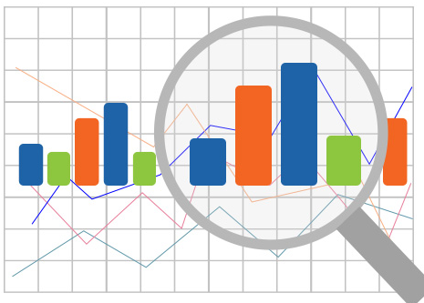
How to use GGPlot
Info@stepupanalytics.com

Slide 2
What is ggplot2?
Graphics framework available in R

Slide 3
The Setup
# Setup
options(scipen=999) # turn off scientific notation like 1e+06
library(ggplot2)
data("midwest", package = "ggplot2") # load the data
# midwest <- read.csv("http://goo.gl/G1K41K") # alt source
# Init Ggplot
# area and poptotal are columns in 'midwest‘
# aes() function is used to specify the X and Y axes.
ggplot(midwest, aes(x=area, y=poptotal))
Notes:
http://r-statistics.co/Complete-Ggplot2-Tutorial-Part1-With-R-Code.html#1.%20Understanding%20the%20general%20ggplot%20format

Slide 4
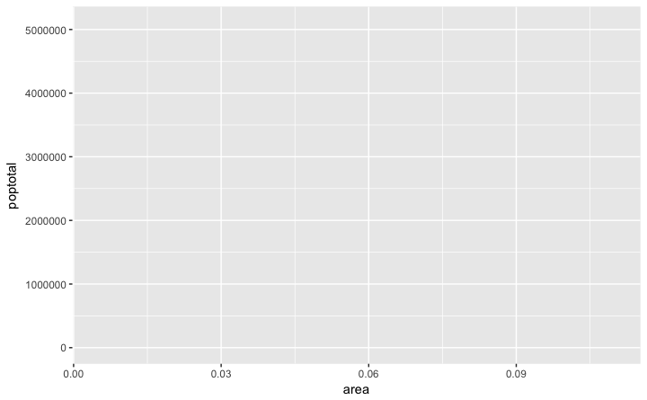
The Setup - Output

Slide 5
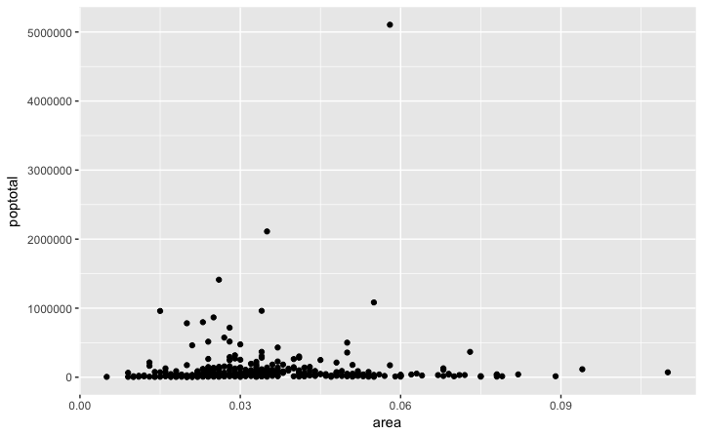
How to Make a Simple Scatterplot
Let’s make a scatterplot on top of the blank ggplot by adding points using a geom layer called geom_point.
ggplot(midwest, aes(x=area, y=poptotal)) + geom_point()
Like geom_point(), there are many
such geom layers which we will
see.
For now, let’s just add a smoothing
layer using geom_smooth

Slide 6
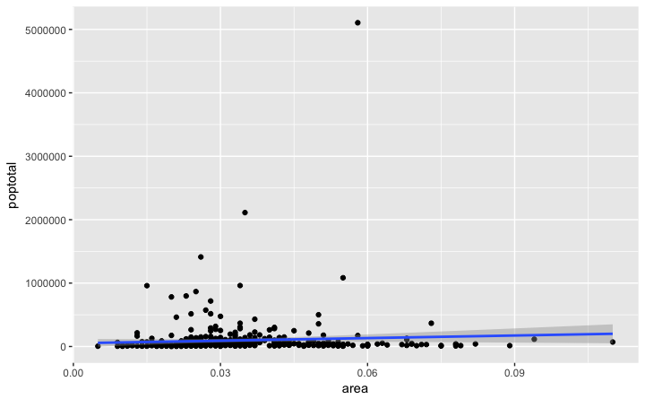
How to Make a Simple Scatterplot
g <- ggplot(midwest, aes(x=area, y=poptotal)) + geom_point() + geom_smooth(method="lm") # set se=FALSE to turnoff confidence bands
plot(g)

Slide 7
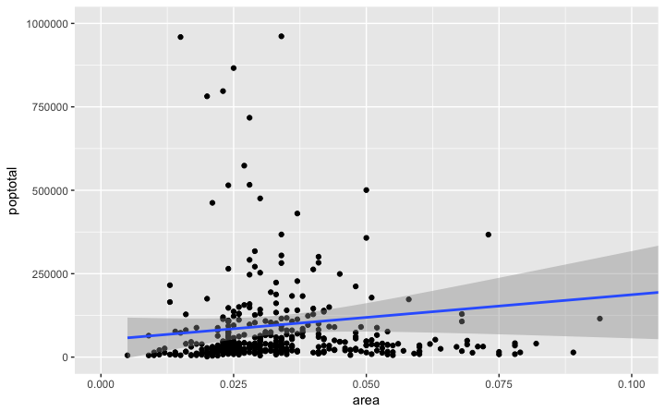
Adjusting the X and Y axis limits
g <- ggplot(midwest, aes(x=area, y=poptotal)) + geom_point() + geom_smooth(method="lm")
g1 <- g + coord_cartesian(xlim=c(0,0.1), ylim=c(0, 1000000)) # zooms in
plot(g1)

Slide 8
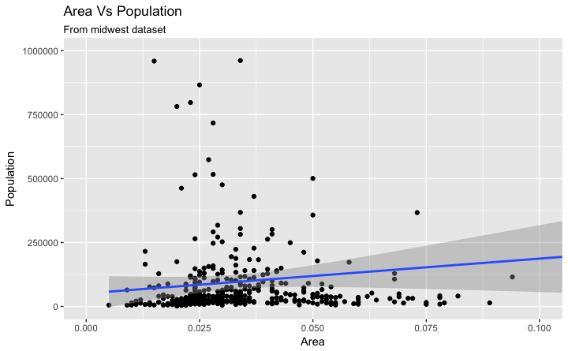
How to Change the Title and Axis Labels
g1 + labs(title="Area Vs Population", subtitle="From midwest dataset", y="Population", x="Area", caption="Midwest Demographics")

Slide 9
The full function call
# Full Plot call
library(ggplot2)
ggplot(midwest, aes(x=area, y=poptotal)) +
geom_point() +
geom_smooth(method="lm") +
coord_cartesian(xlim=c(0,0.1), ylim=c(0, 1000000)) +
labs(title="Area Vs Population", subtitle="From midwest dataset", y="Population", x="Area", caption="Midwest Demographics")

Slide 10
How to Change the Color and Size of Points
gg <- ggplot(midwest, aes(x=area, y=poptotal)) +
geom_point(aes(col=state), size=3) + # Set color to vary based on state categories.
geom_smooth(method="lm", col="firebrick", size=2) +
coord_cartesian(xlim=c(0, 0.1), ylim=c(0, 1000000)) +
labs(title="Area Vs Population", subtitle="From midwest dataset", y="Population", x="Area", caption="Midwest Demographics")
plot(gg)

Slide 11
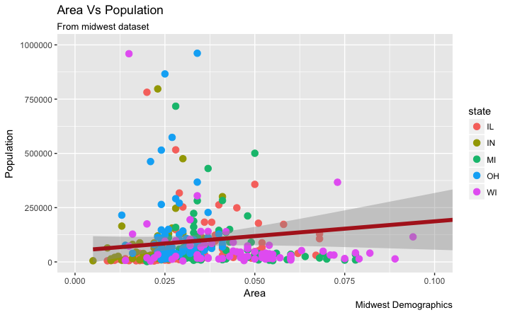
How to Change the Color and Size of Points

Slide 12


